Slide 1



September
Pack Meeting
9/20/23
Notes:
The following slideshow may be adjusted to fit your unit’s needs. To facilitate the Orientation please select print note pages when you print the document in order to get all of the information that goes with each slide. Feel free to customize the presentation as necessary. Slides 13-17 may be customized as needed by the unit. Units may choose to abridge slides 6 and 7 depending on how soon after the start of the Cub Scouting year the New Family Orientation has taken place.

Slide 2

Sign’s up!

Slide 3
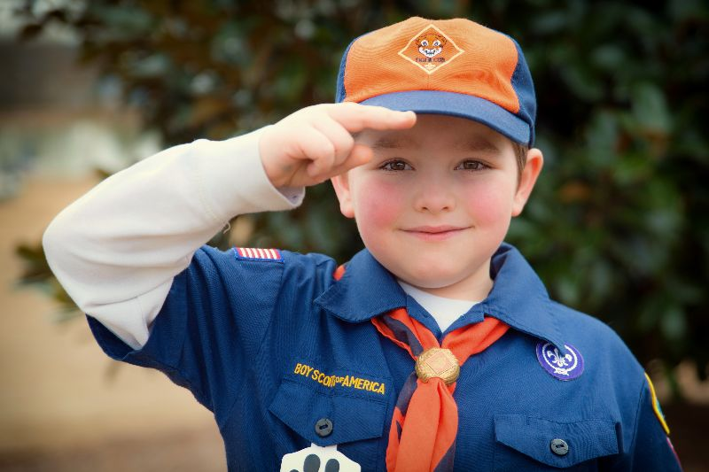

Opening Flag Ceremony
Den 2
Scout Salute: two fingers to right brim or eyebrow

Slide 4


Slide 5

The Scout Law
A Scout is
Trustworthy
Loyal
Helpful
Friendly
Courteous
Kind
Obedient
Cheerful
Thrifty
Brave
Clean
Reverent

Slide 6
Today’s agenda
Game Time!
Scout Value for the September: Kindness
Resources and Where to Find Info
2023/24 Pack Plans
Pack Dues and how to Pay them
Popcorn Moment

Slide 7

Game 1: Aeroscout Engineering
Scouts (with minimal adult supervision) grab a piece of paper and build a paper airplane.
Be sure to write your name on your plane.
We’ll launch them 3 times to measure distance traveled, and the top three scout planes will be awarded a prize.
1st Place: Candy
2nd Place: Candy
3rd Place: Still Candy

Slide 8
Game 2: Candy Count
Before you start building your plane:
Get a slip of paper and write down your name and your guess of the number of candies in the jar, fold it up, and place it in the bag.
The closest guess to the actual count wins.
Prize: The Jar of Candy

Slide 9
Core Value: A Scout is KIND
"A Scout is kind. A Scout knows there is strength in being gentle. He treats others as he wants to be treated. Without good reason, they do not harm any living thing.”
Can you think of examples?
  Kindness should be first practiced by a Scout in his/her own home.
  A Scout needs to demonstrate kindness to these people in order to build friendships and strengthen his/her character.
  Show kindness to the natural world (animals, plants, etc)
  Be kind with no expectation of getting something in return

Slide 10
Resources… starting with our volunteer leaders

Slide 11
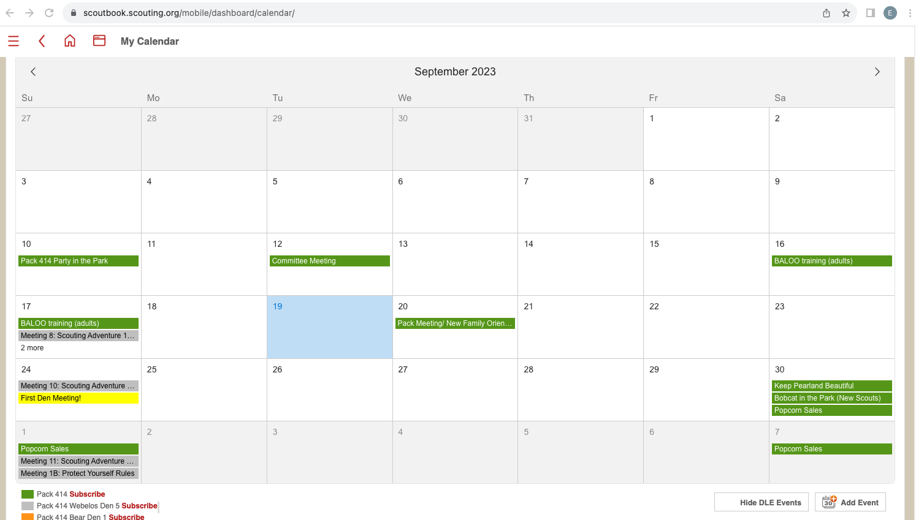
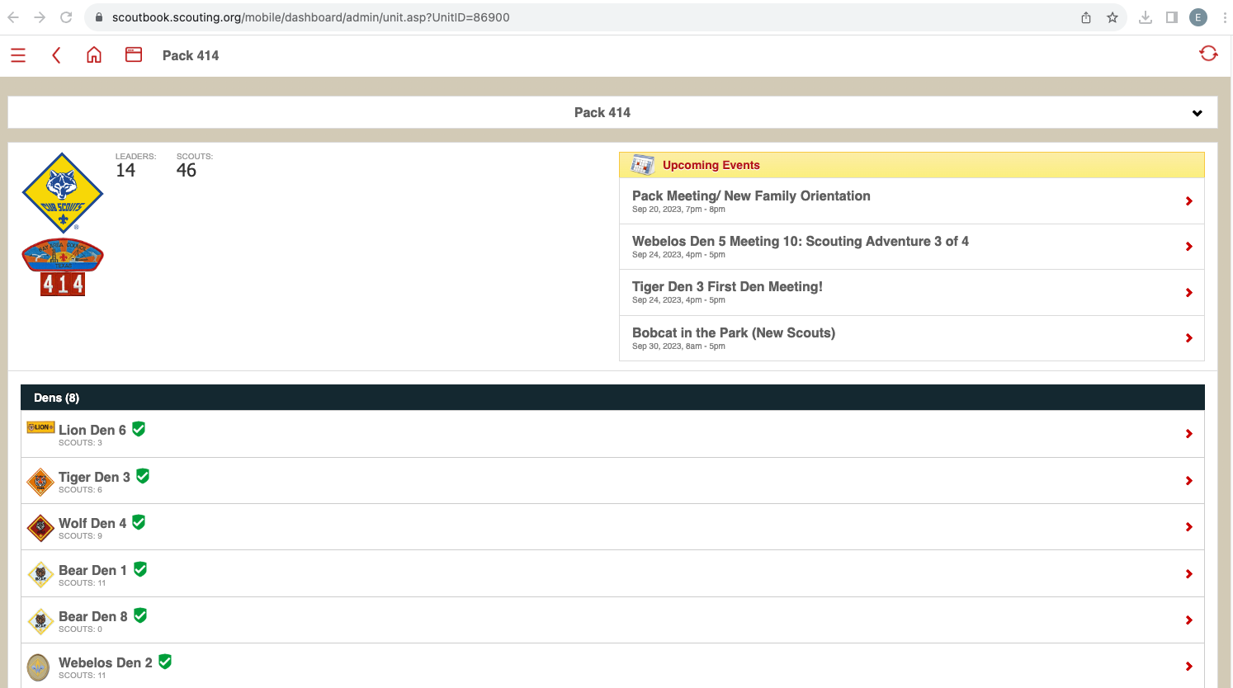
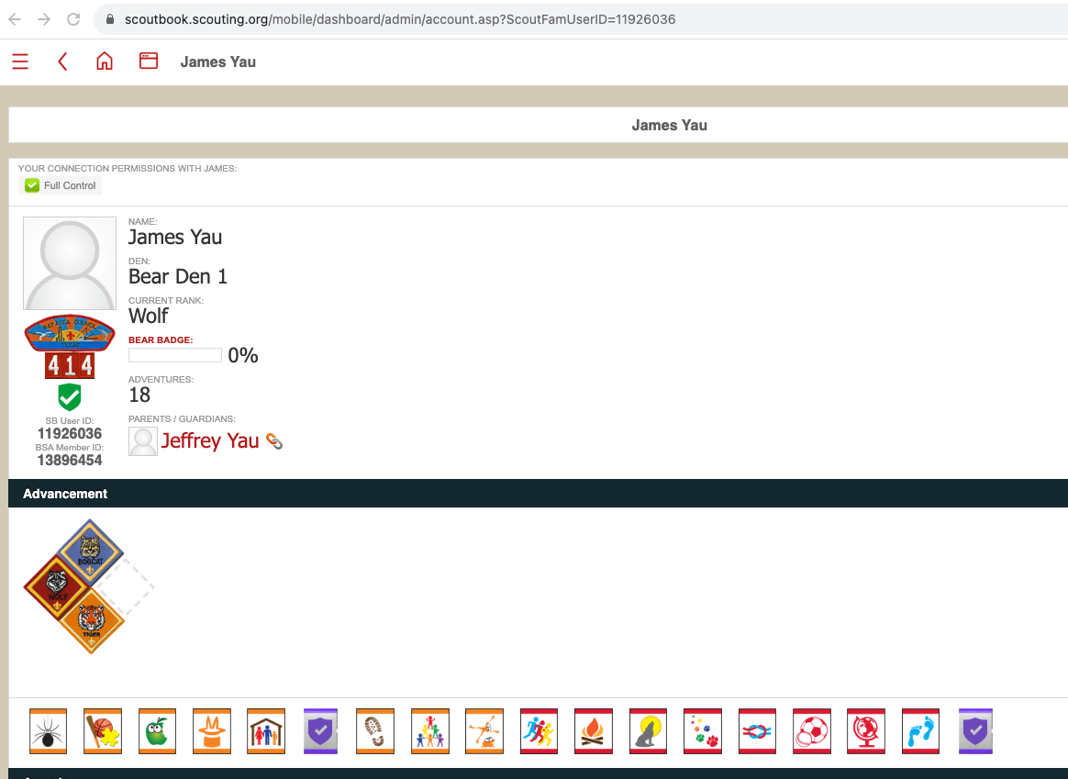
Scoutbook
See Pack calendar for upcoming events!
Main dashboard
See/update your scout’s info and progress! (talk to your den leader…)

Slide 12
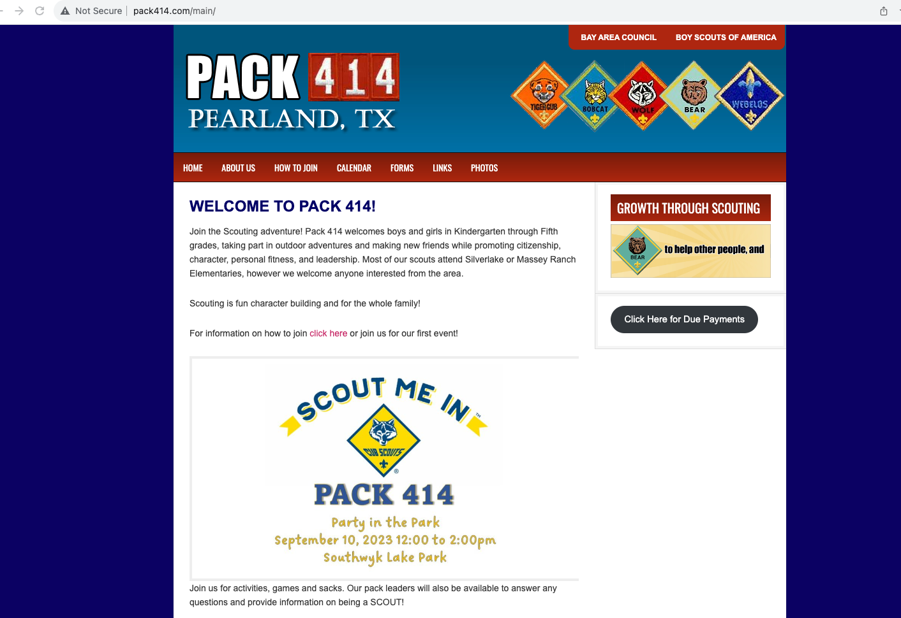
Pack website
pack414.com

Slide 13
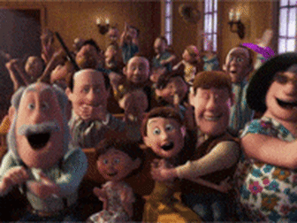
What will Pack 414 do this year?

Slide 14
General scheduling scheme
(determined at annual planning meeting each May)
Scouting “Year” runs from August-May
One pack meeting per month (Southwyck Lake Park or RMS)
Den meetings (see your den leader)
One campout per month
Service (Keep Pearland Beautiful): 2x Fall and 2x Spring
Pack activities: Rocket Launch, Pinewood Derby, Blue&Gold
Possible/optional activities: Camp K Native American Weekend, Pearland Christmas Parade
(For parents) One Committee meeting per month

Slide 15
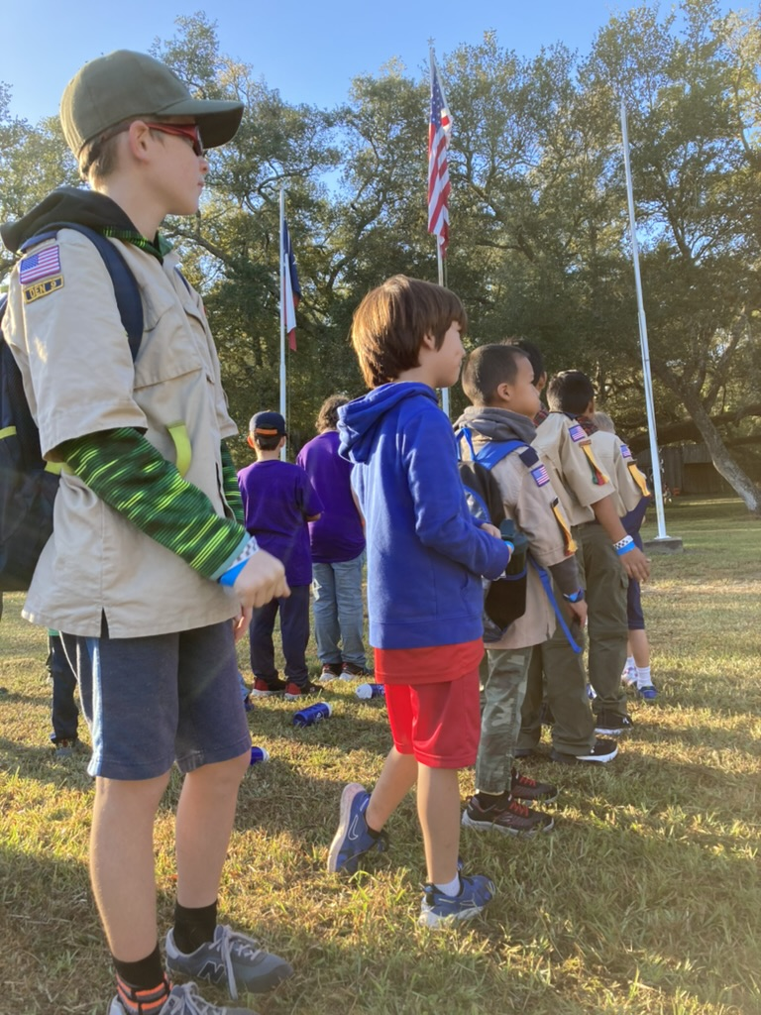

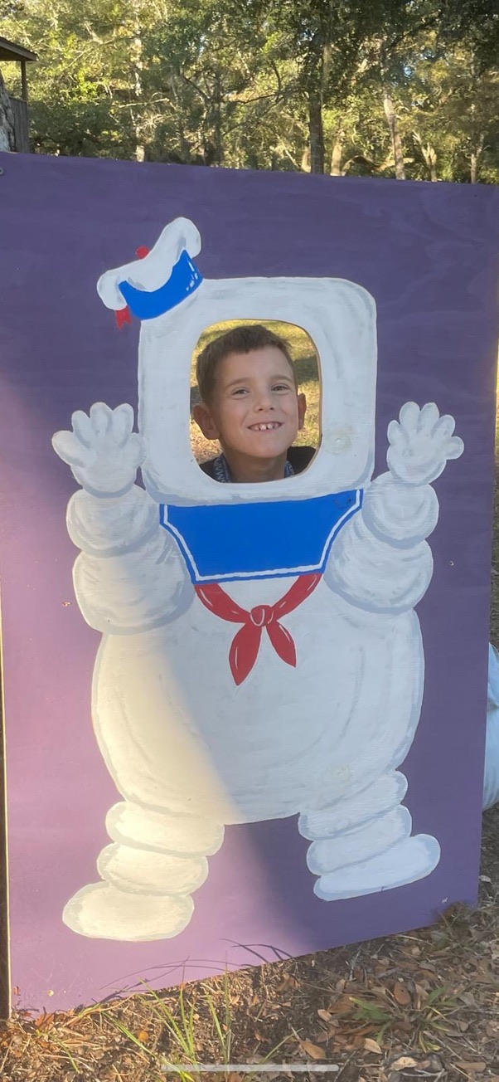
October campout: Ghosts & Goblins
www.Bacbsa.org/activities

Slide 16
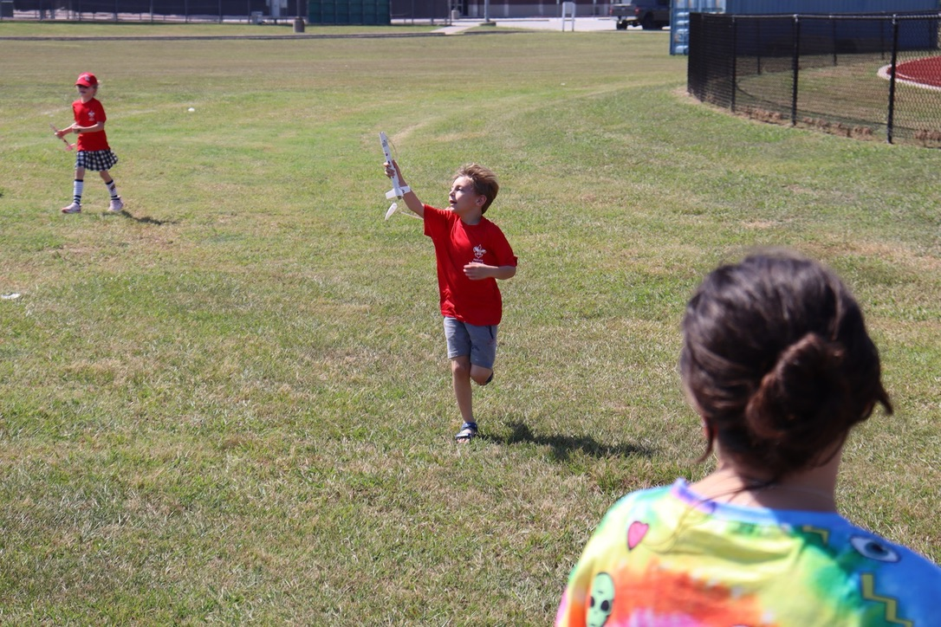
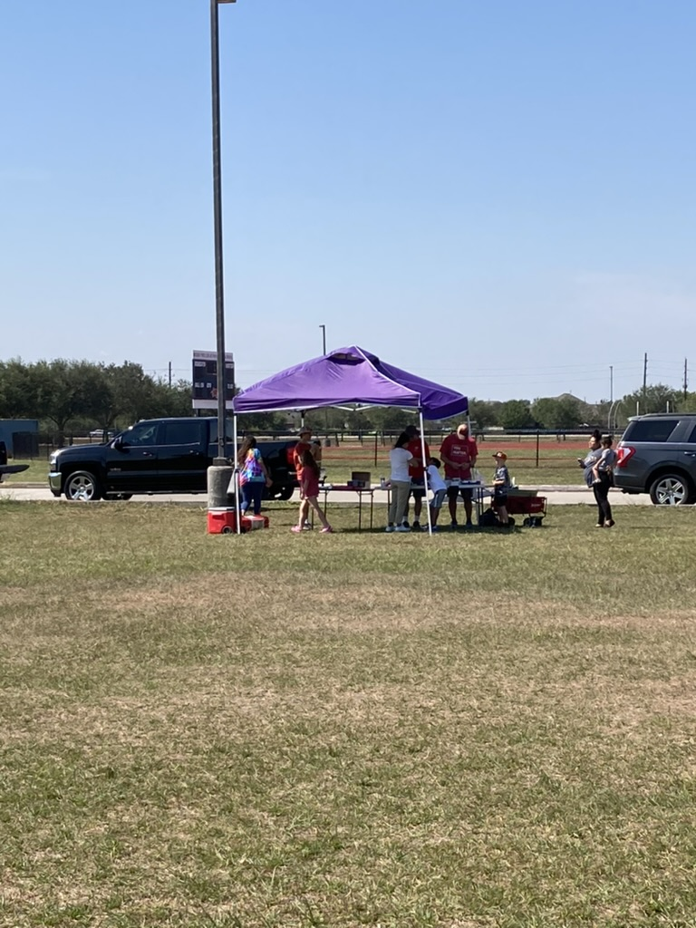
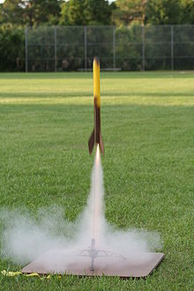
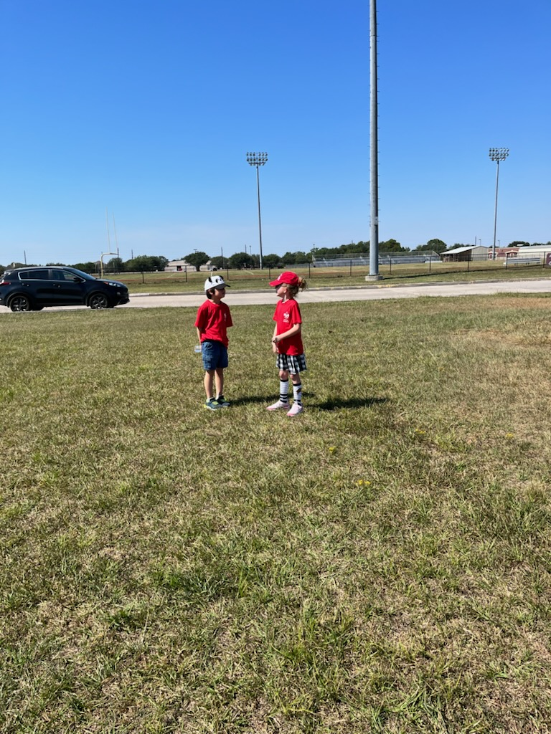
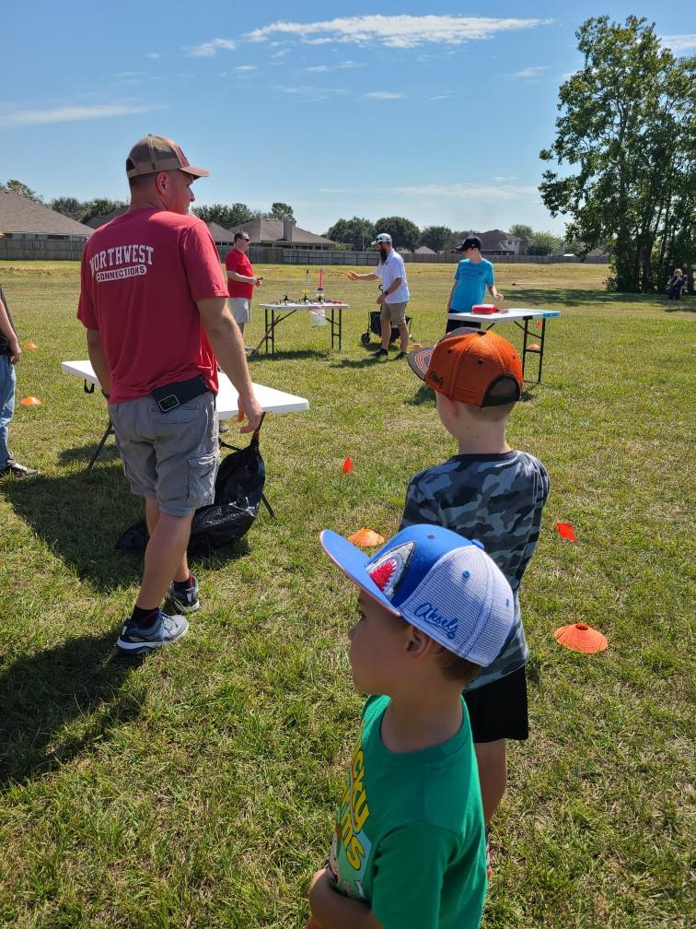
Rocket Launch

Slide 17
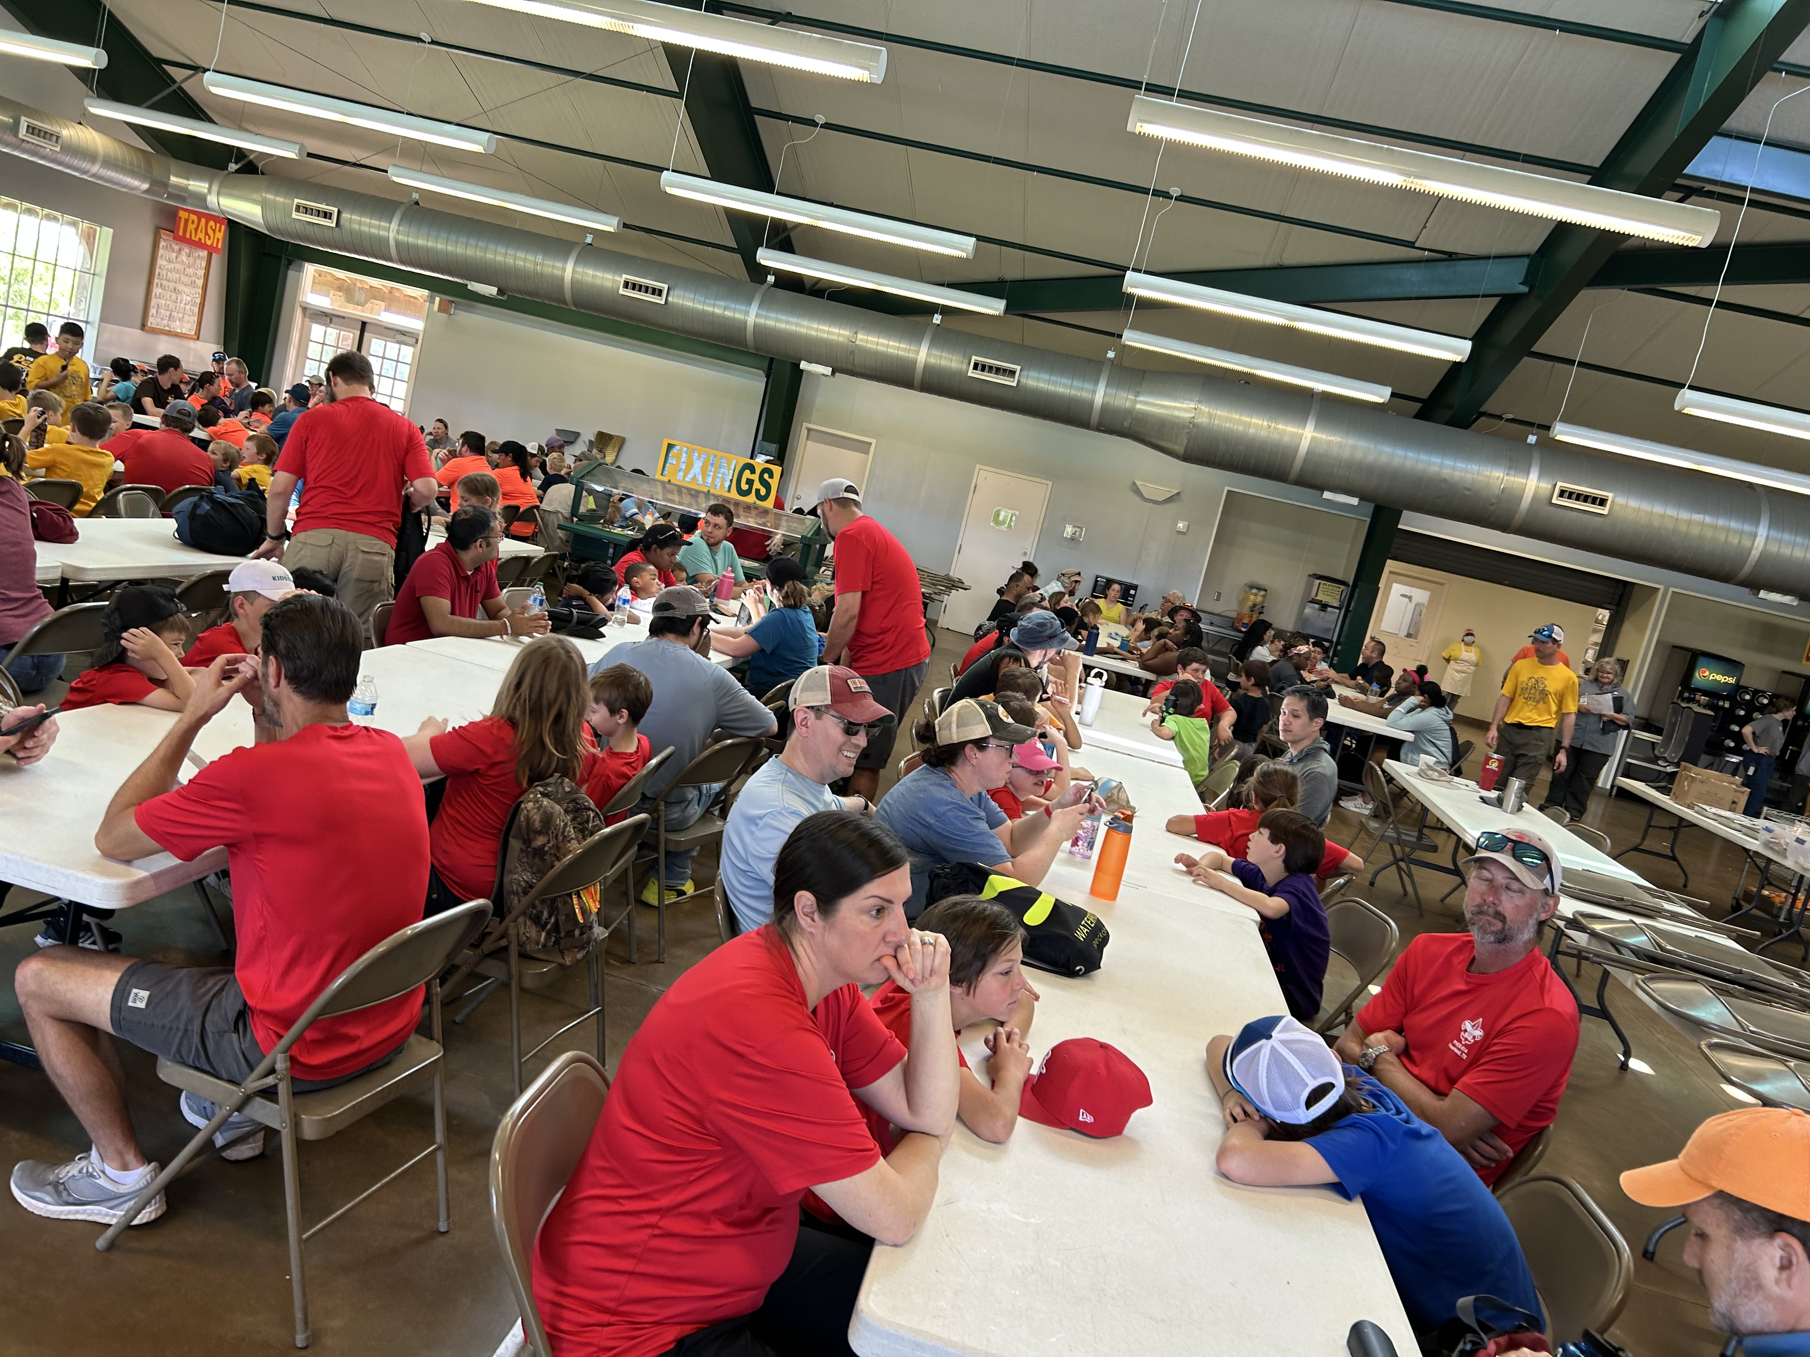
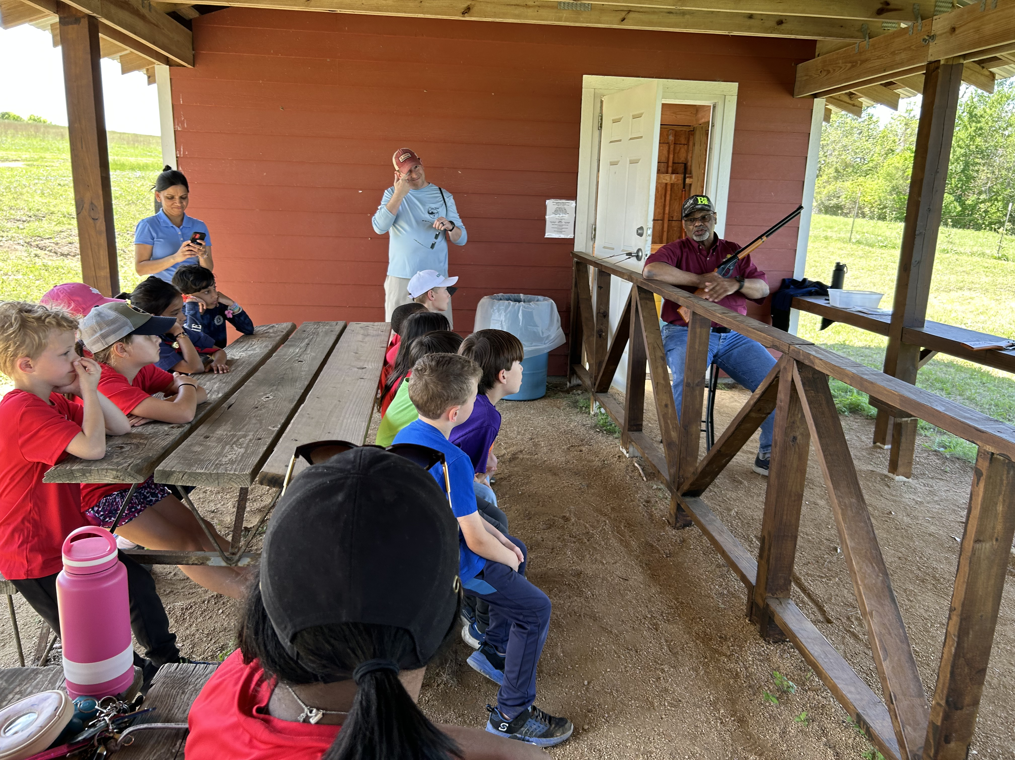
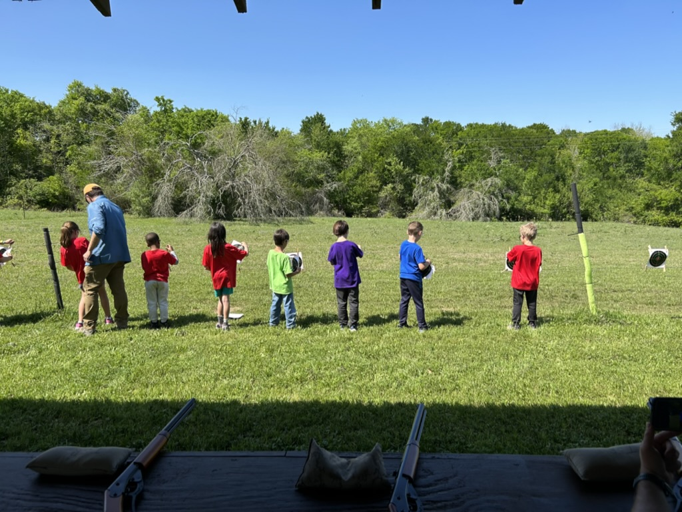
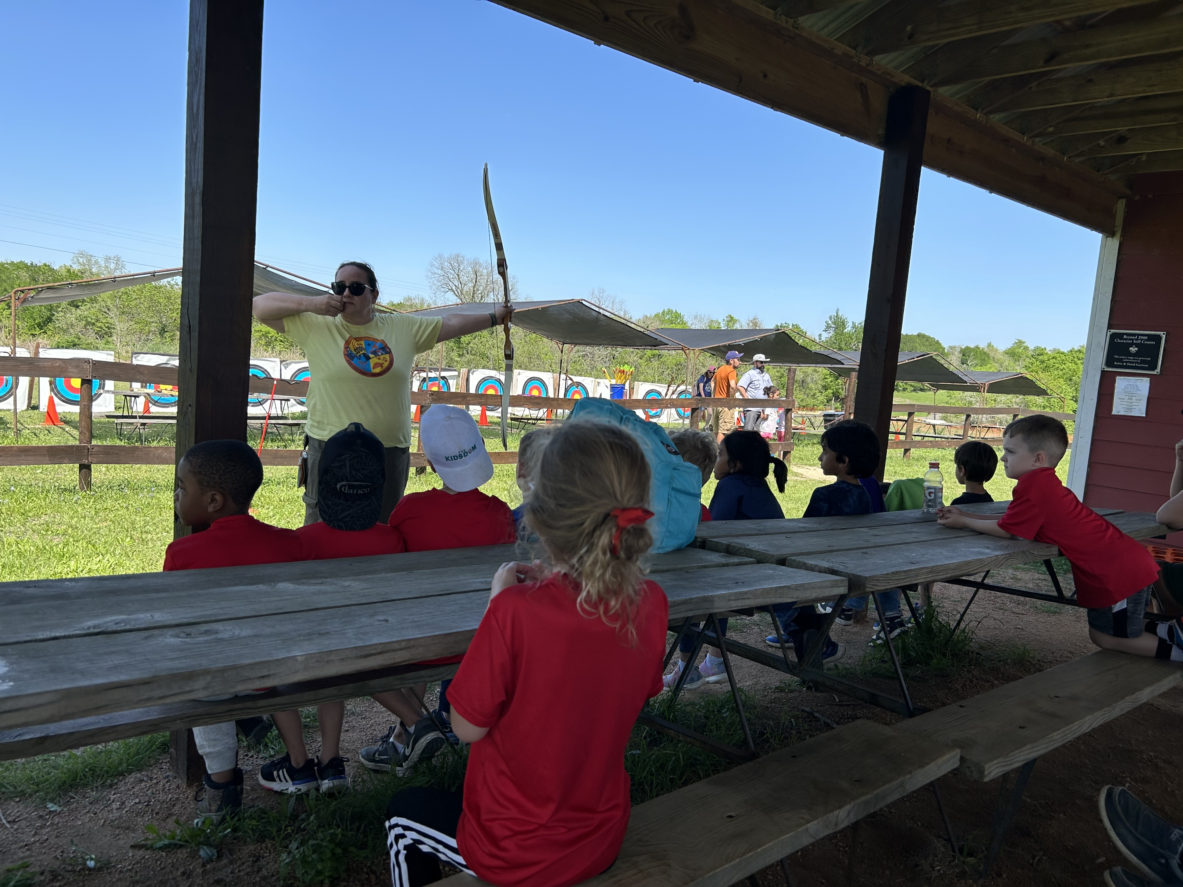
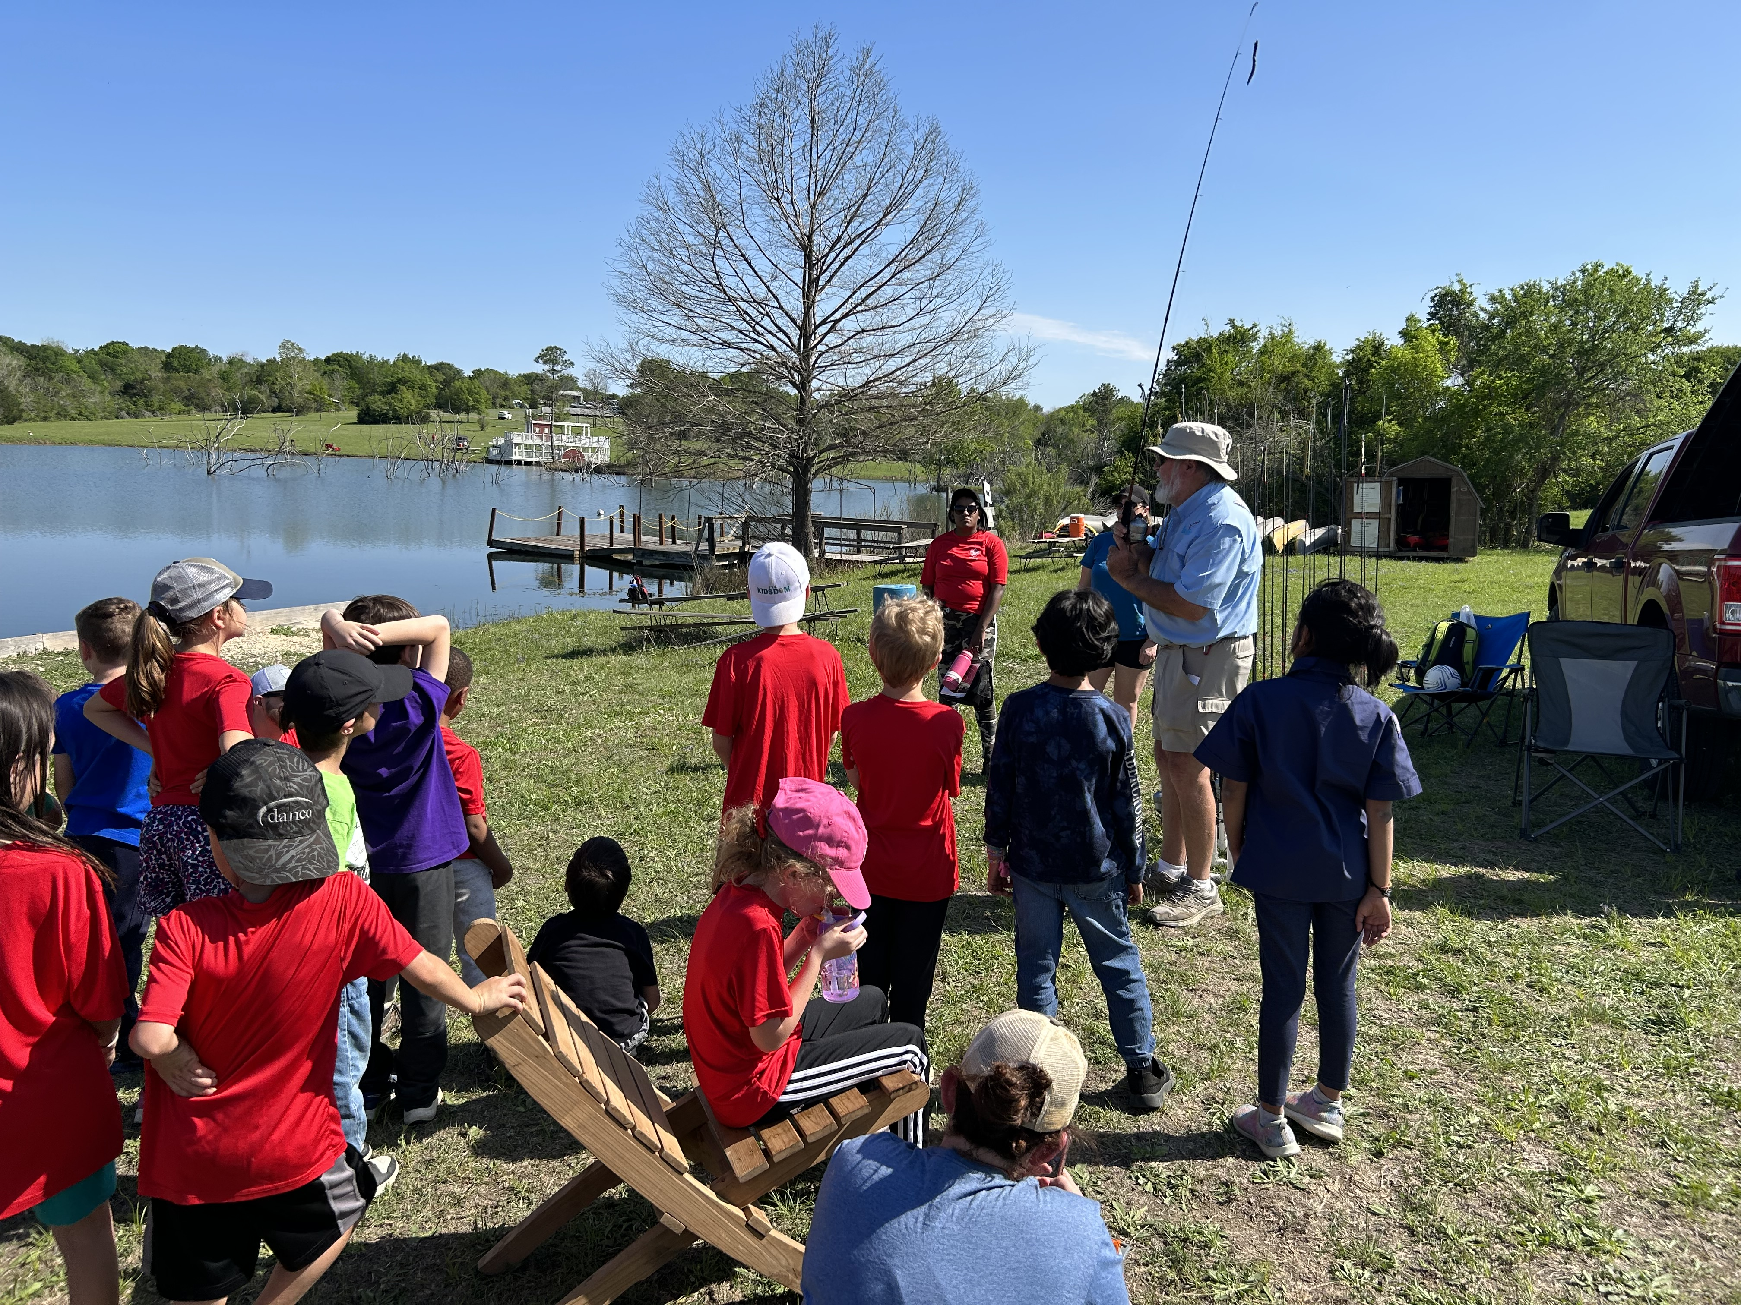
November campout: Camp Bovay

Slide 18
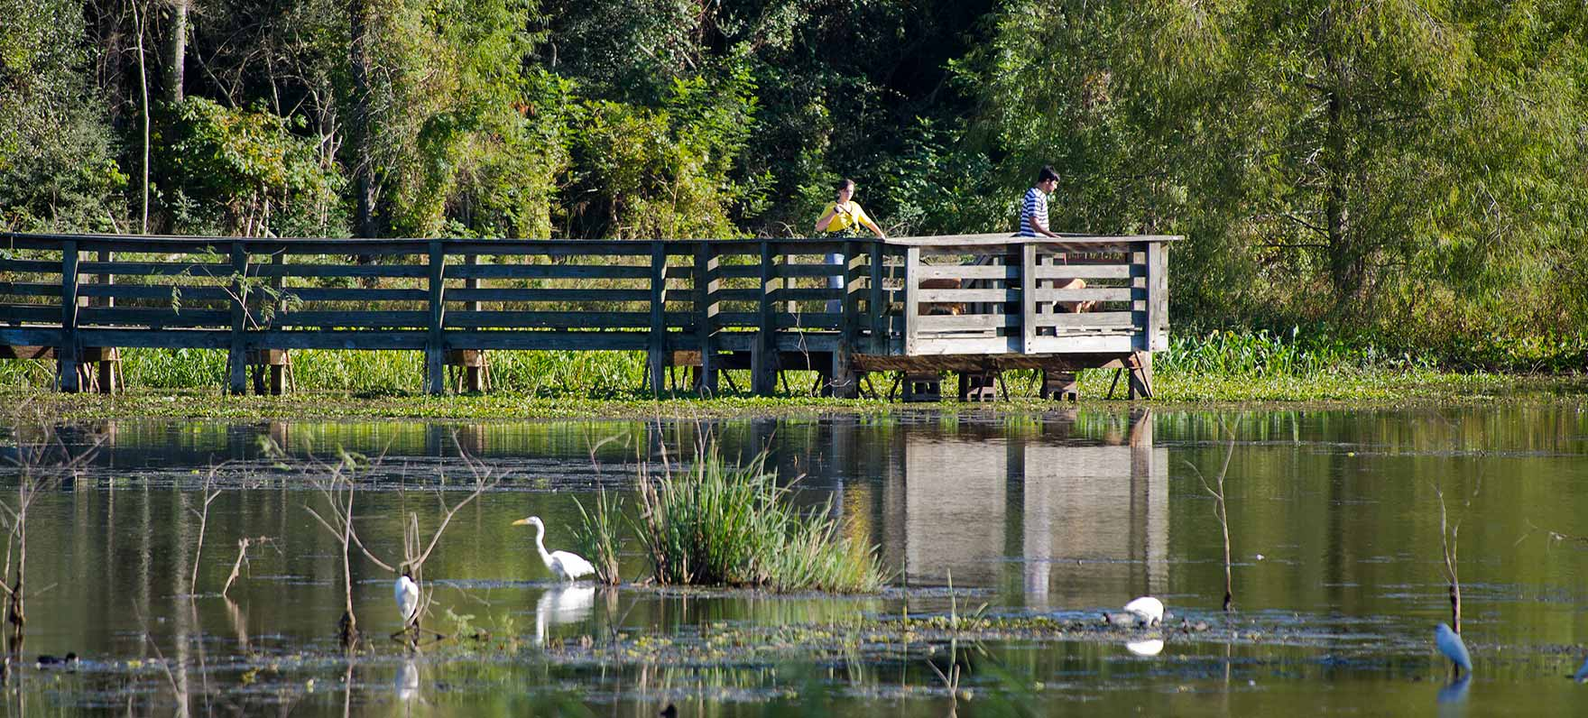
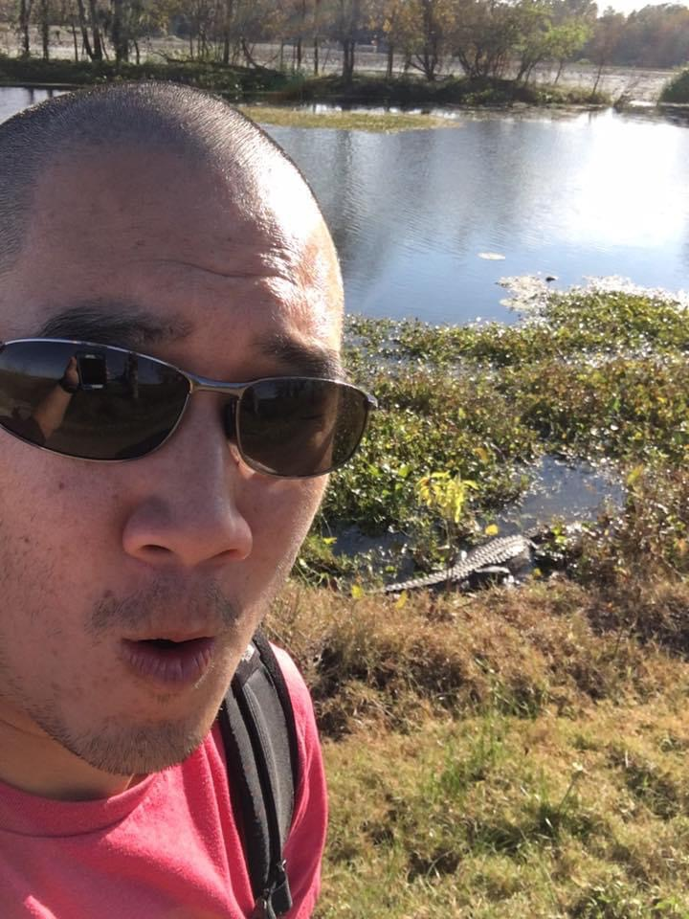

December campout: Brazos Bend State Park

Slide 19

January camp(in):
Lone Star Flight Museum

Slide 20
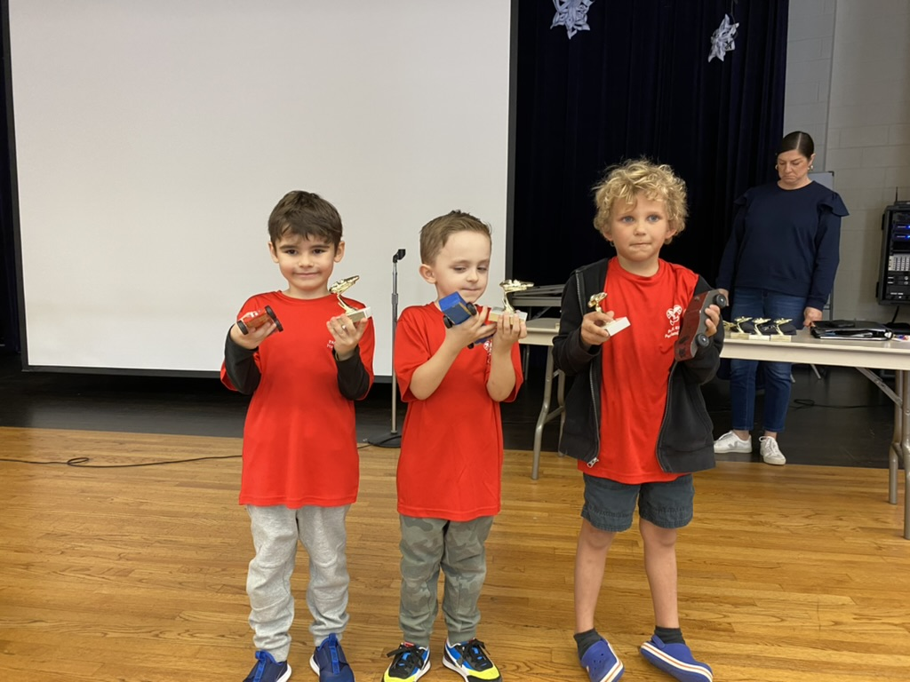
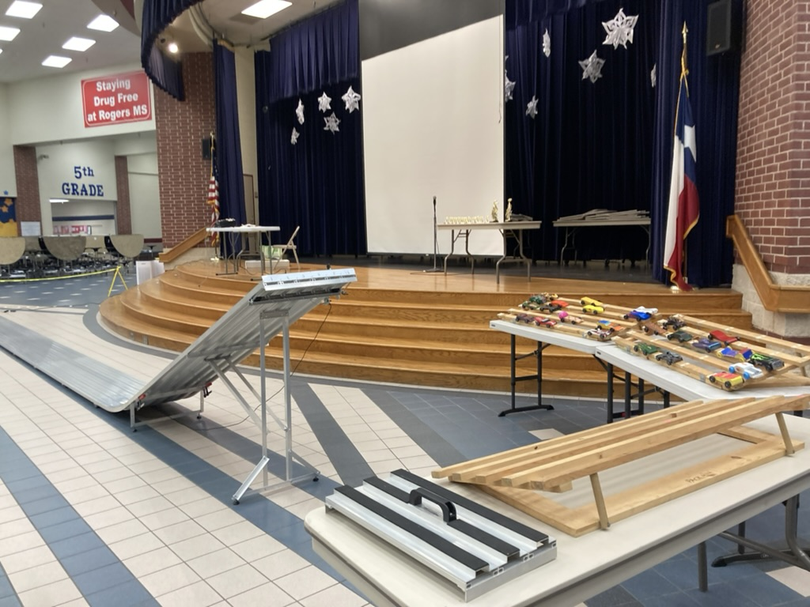
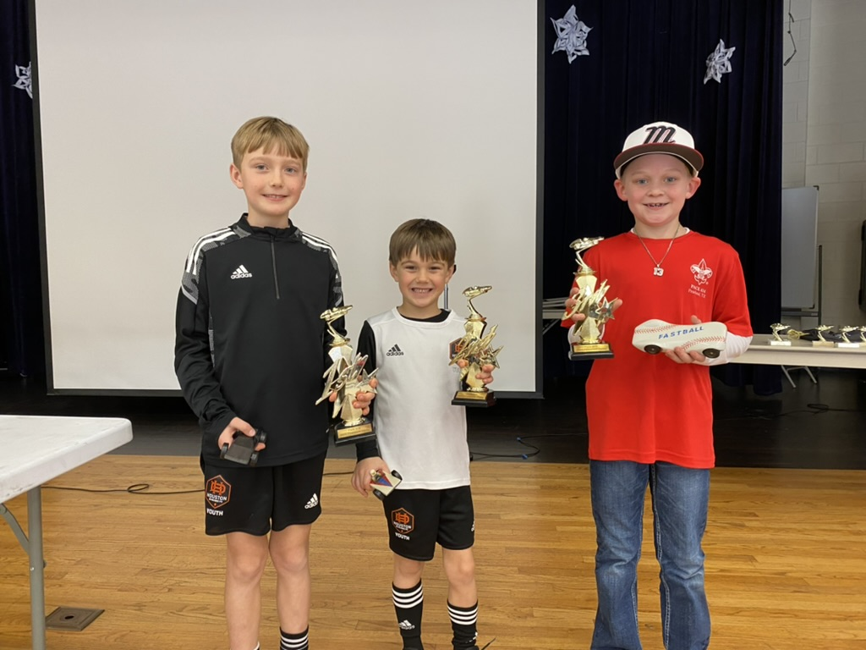
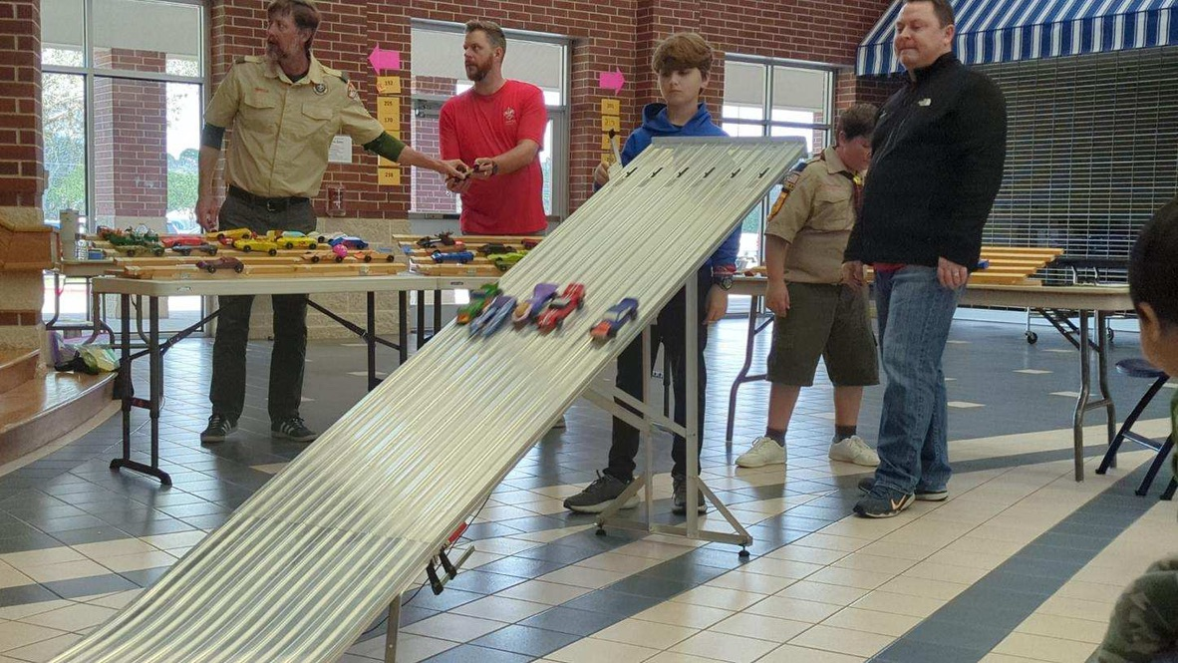
Pinewood Derby

Slide 21
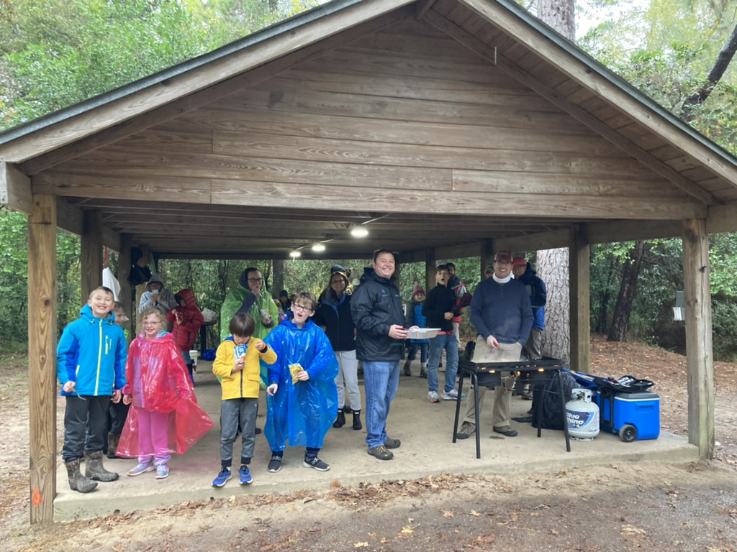
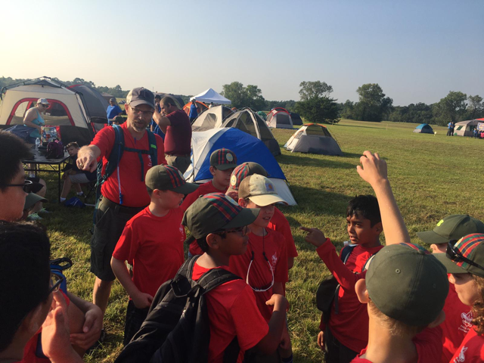
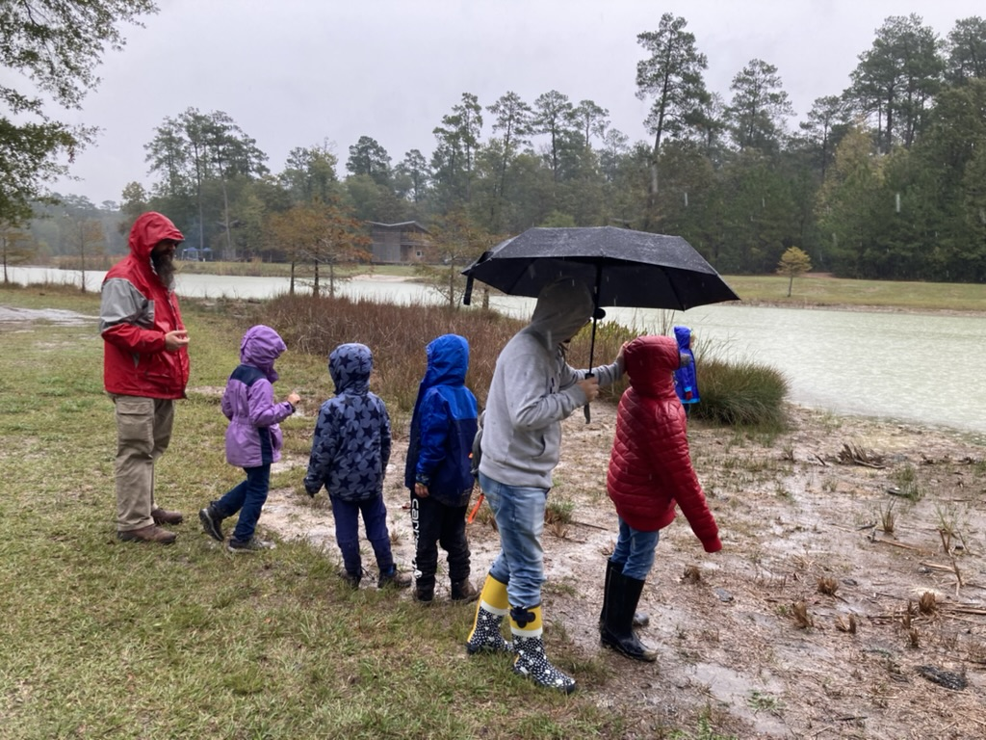
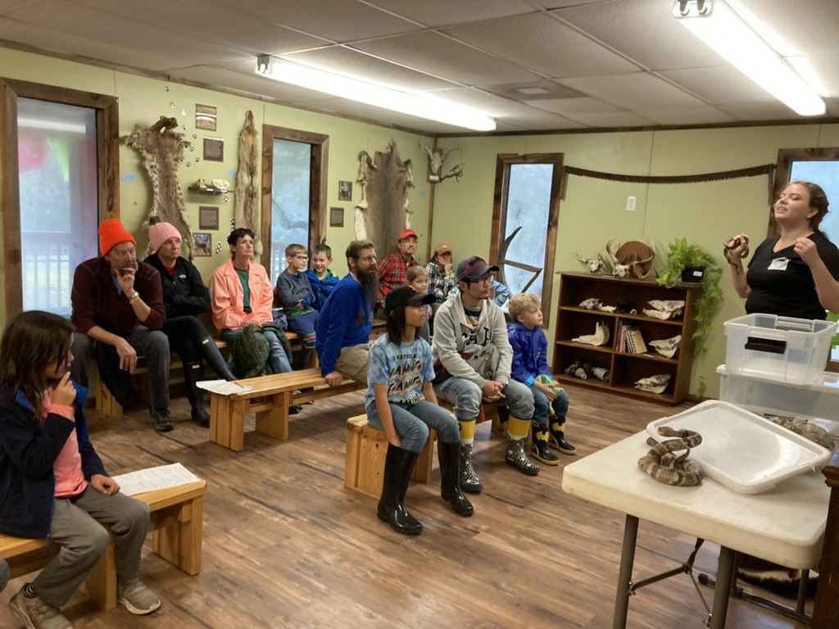
March campout:
Lake Houston

Slide 22
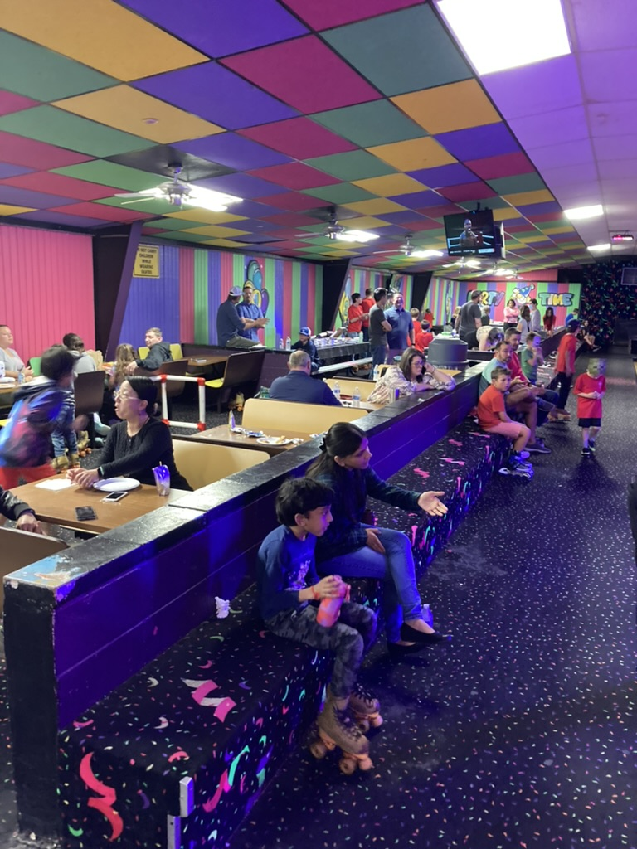
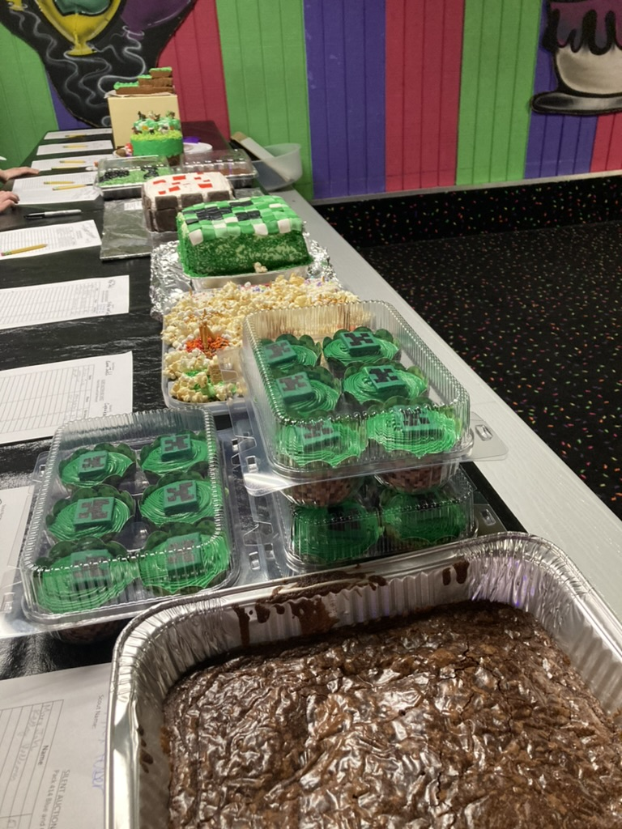
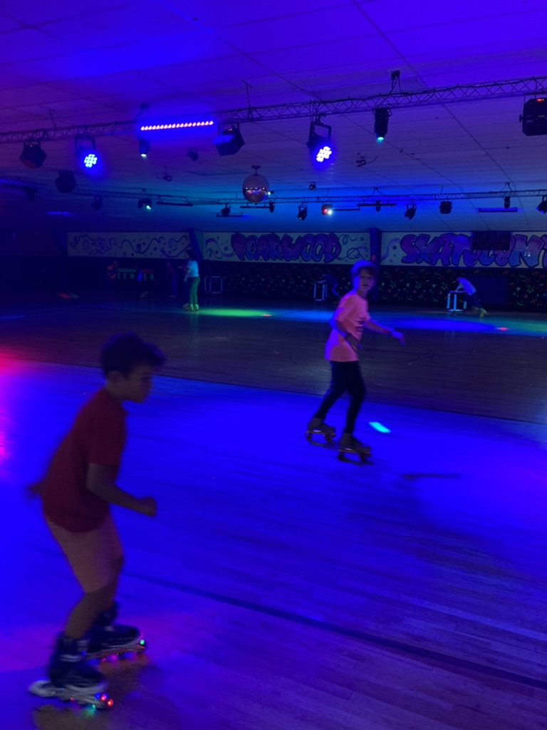
Blue & Gold Banquet

Slide 23
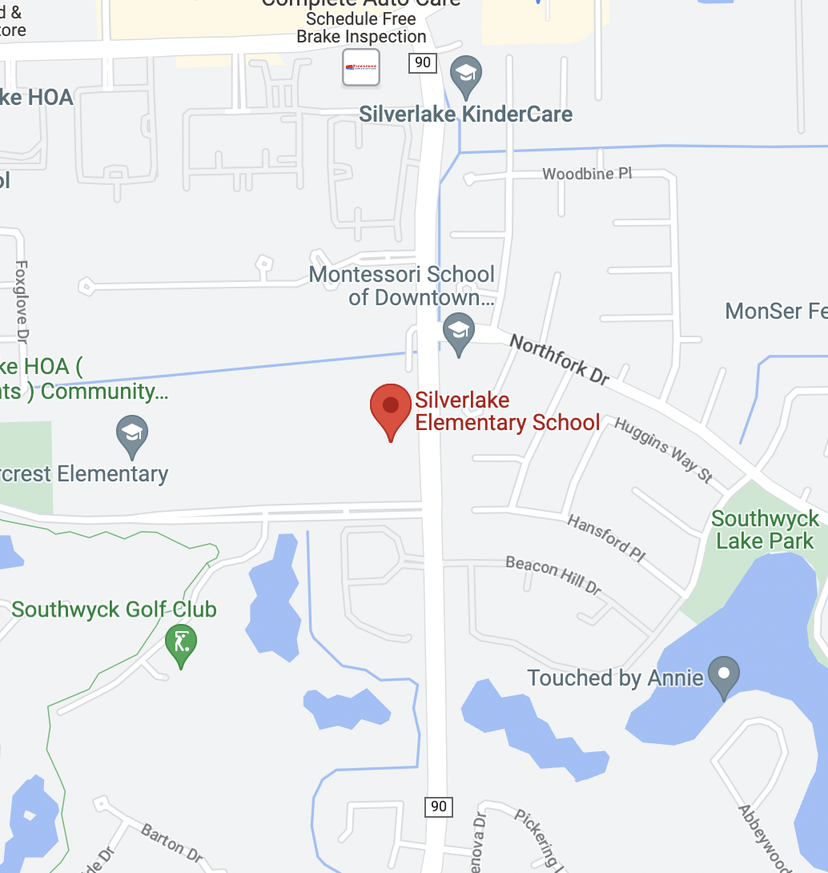
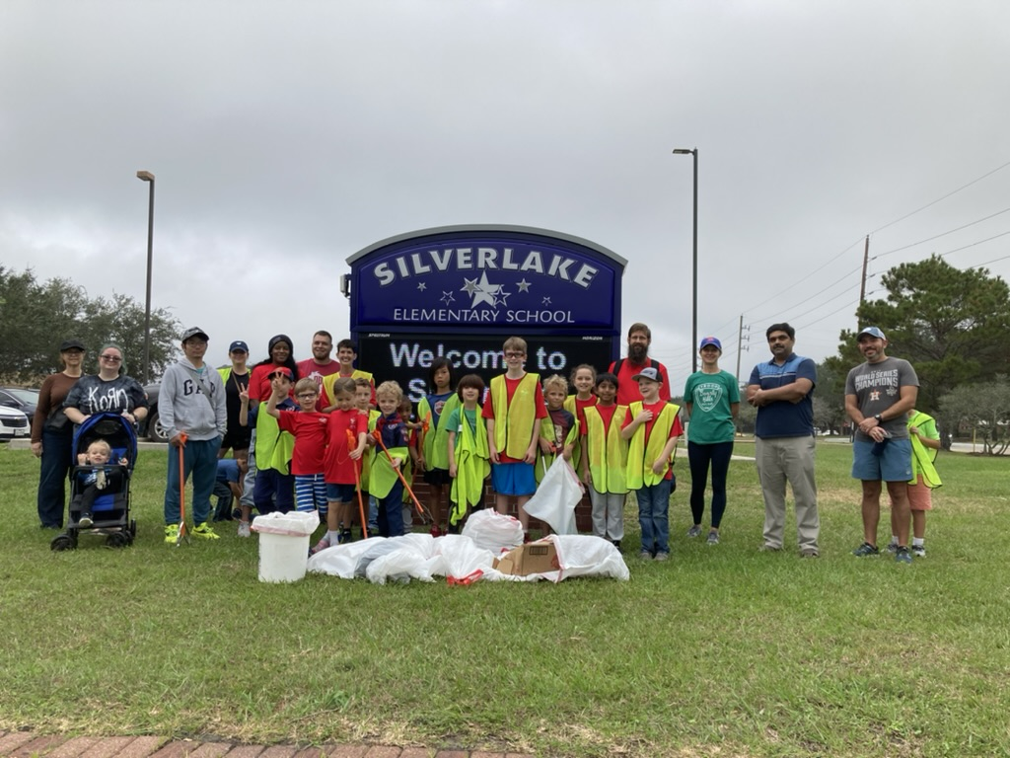
Keep Pearland Beautiful

Slide 24

Volunteers needed for 2023-24!
Membership Deputy (work w/ Bing)
Pinewood Derby Chair
Blue and Gold Chair
Social Media Chair
Others???

Slide 25
WHO WON THE CANDY COUNT?

Slide 26
What’s coming up immediately
9/30: Bobcat in the Park (new scouts only)
9/29-10/1: Webelos Woods (Webelos and AOL only)
9/30: Keep Pearland Beautiful
Popcorn fundraiser

Slide 27
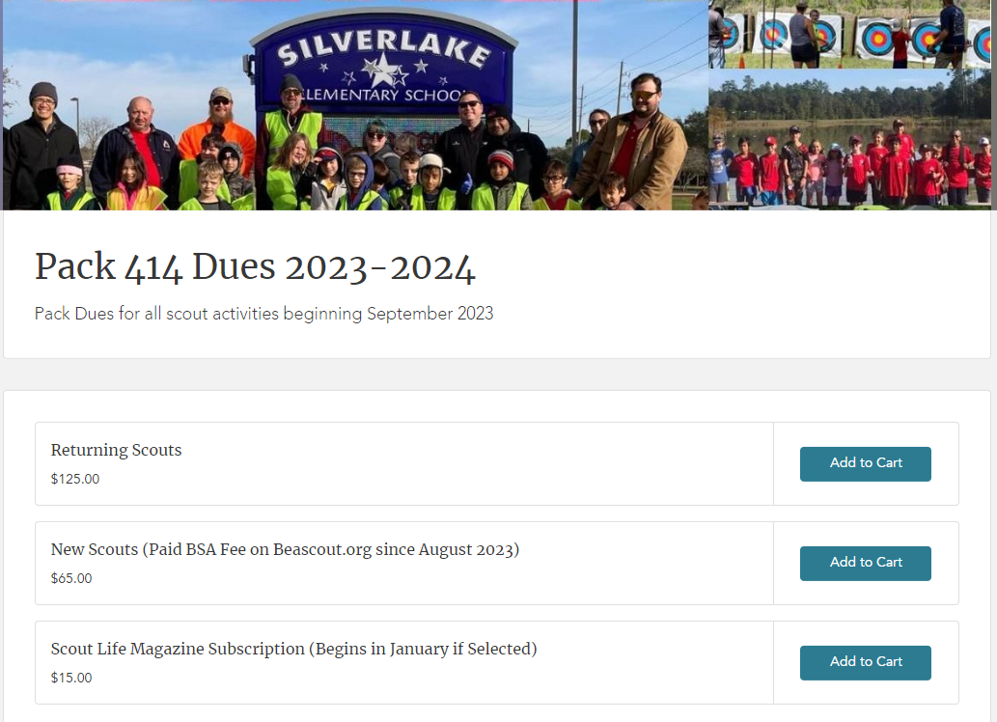
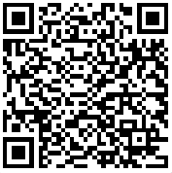
Pack Dues for 2023/24
$125/scout for the Year
Link to Pay via Credit Card

Slide 28
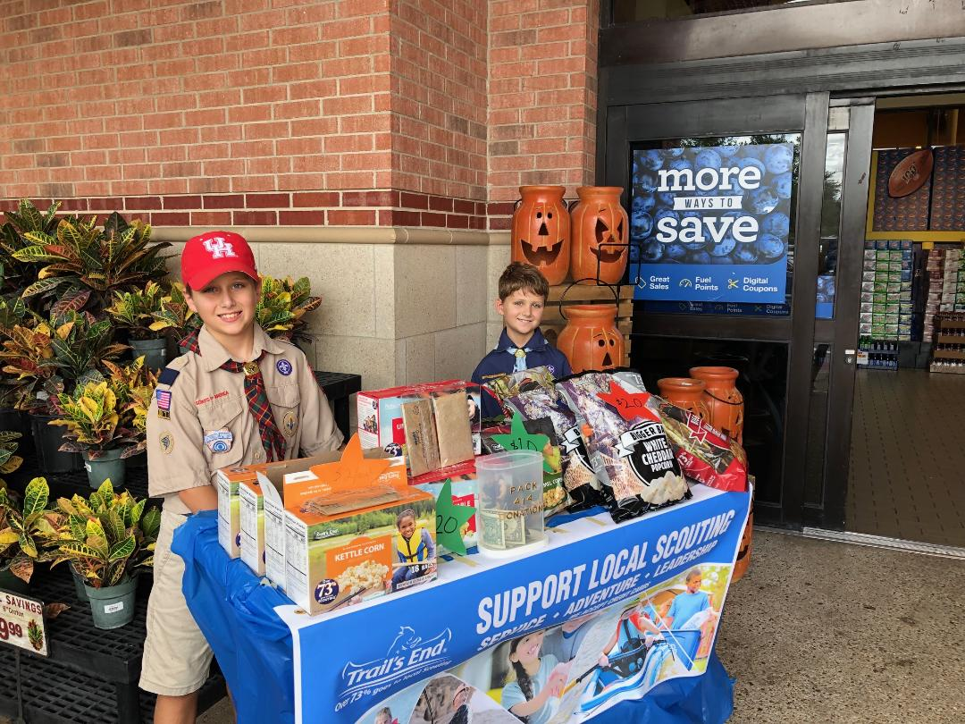

POPCORN SALES
It is our Pack’s only Fundraiser for the year.
1/3 of sales go back to Pack to offset activity costs and dues!
It takes each and every family’s participation to make it successful

Slide 29
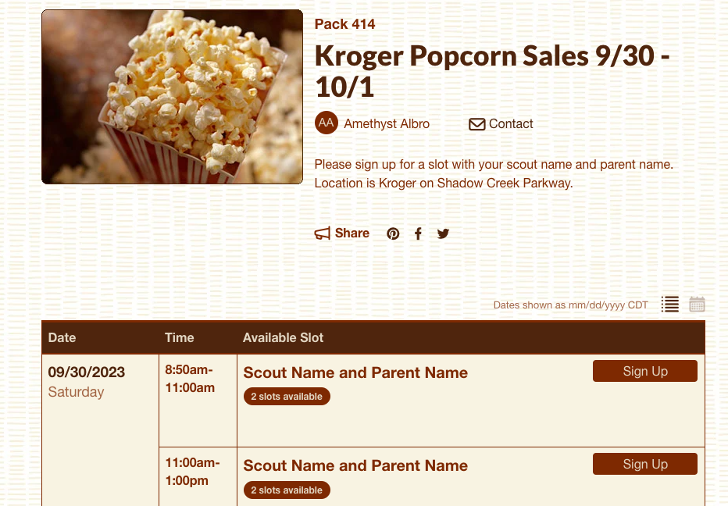
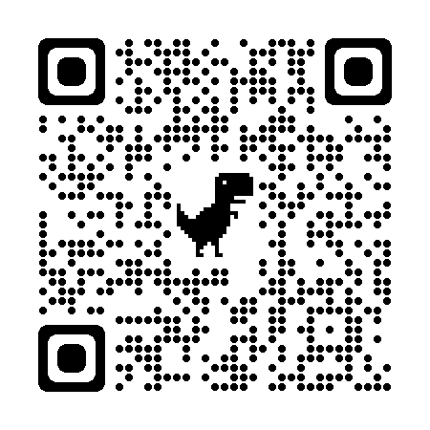
How to Join the Pack for the First Time

Slide 30

Thank you for your participation, Parents and Scouts!
Let’s have a great Scouting year!

Slide 31
Clean Up!
Everyone please help clean up, and leave the school cleaner than we found it!

